Slide 1
Automation framework
Selenium and Page object model

Slide 2

Content
Selenium
Selenium Advantages
Nunit
POM
Test Project Design
Test Driven Development

Slide 3
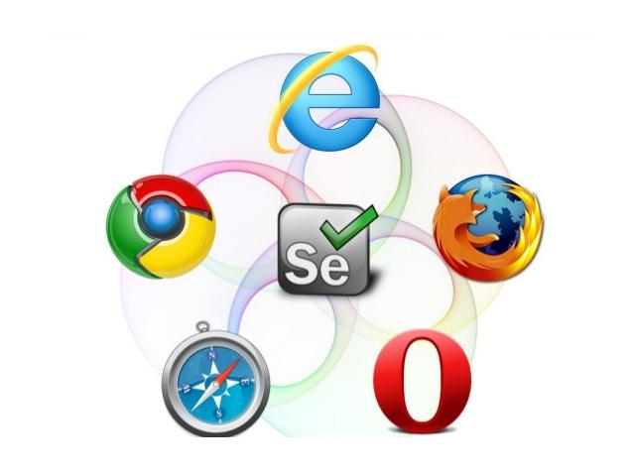
Selenium automates browsers. Selenium has the support of some of the largest browser vendors who have taken (or are taking) steps to make Selenium a native part of their browser.
Test tool for web applications
Runs in any mainstream browser
Supports tests in many languages
Selenium(pure HTML, no backend required)
Java, C#, Perl, Python, Ruby
Record/playback (Selenium IDE)
Open Source with corporate backing
Lives at selenium.openqa.org

Slide 4
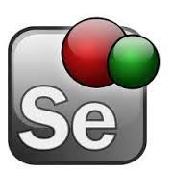
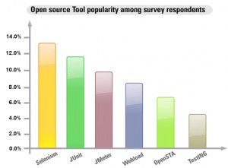
Why Selenium
Support Web-based applications for both the GUI as well as the functionality.
Learning curve due to Core API.
Unit testing tool for JavaScript
selenium IDE is a plugin to Firefox to record and playback tests.
export the recorded test in most language e.g. html, Java , .net , perl , ruby etc. The exported test can be run in any browser and any platform using “selenium remote control”.

Slide 5
Advantages of Selenium
Free!
Can test across multiple browsers
Mimics actual user experience
Ajax / CSS support
Use language of choice
Large user community
Great tools: CubicTest, Grid, HRMES, BrowserStack, third party tools on supports.

Slide 6

Overview of Selenium Components
Selenium IDE - Plugin to Firefox to record and play test in Firefox and also export tests in different languages.
Selenium RC- Allows playing of exported test in different platform/OS.
Selenium Grid -Allows to control lots of selenium machines.
Selenium Web driver 2.0-Driving a browser natively as a user would either locally or on a remote machine using the Selenium Server it marks a leap forward in terms of browser automation.

Slide 7
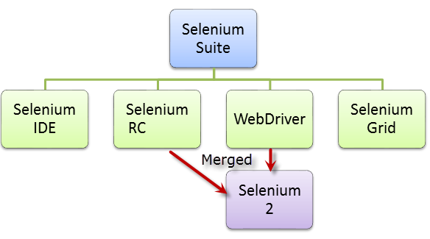

Slide 8
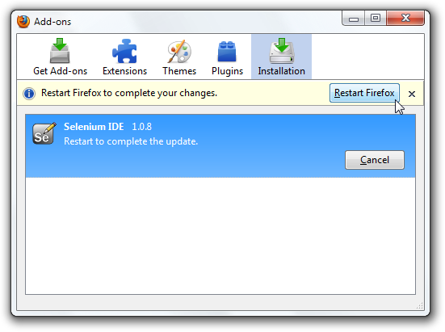
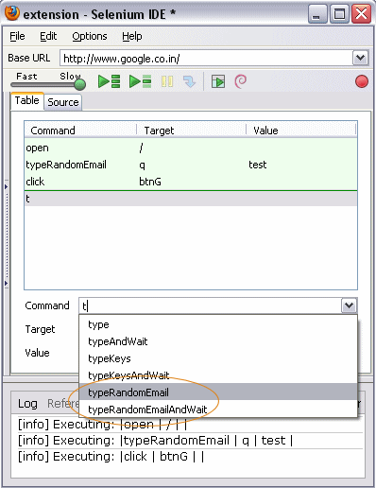
Selenium IDE
Easy record and playback.

Slide 9
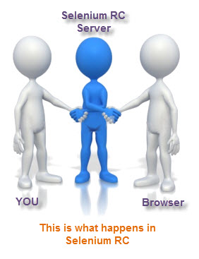
Selenium RC
Selenium Remote Control (RC) is a server, written in Java, that accepts commands for the browser via HTTP.
RC makes it possible to write automated tests for a web application in any programming language, which allows for better integration of Selenium in existing unit test frameworks.
To make writing tests easier, Selenium project currently provides client drivers for PHP, Python, Ruby, .NET, Perl and Java. The Java driver can also be used with JavaScript (via the Rhino engine).

Slide 10
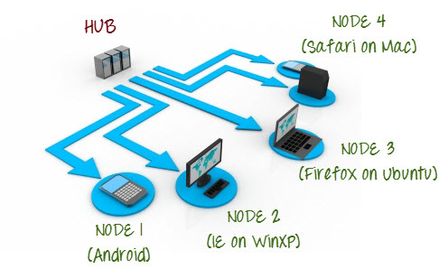
Selenium Grid
Selenium-Grid allows you run your tests on different machines against different browsers in parallel.
That is, running multiple tests at the same time against different machines running different browsers and the operating systems.
Essentially, Selenium-Grid support distributed test execution.
It allows for running your tests in a distributed test execution environment.

Slide 11
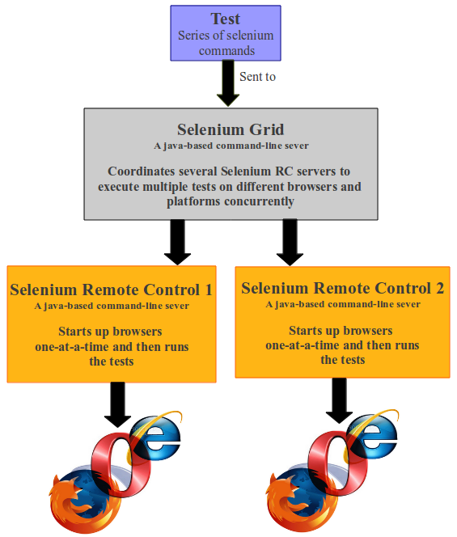
Reasons why you might want to use Selenium-Grid.
To run your tests against multiple browsers, multiple versions of browser, and browsers running on different operating systems.
To reduce the time it takes for the test suite to complete a test pass.

Slide 12
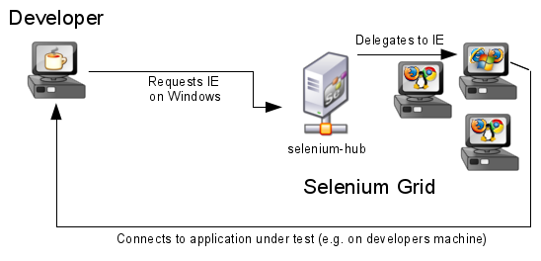

Slide 13
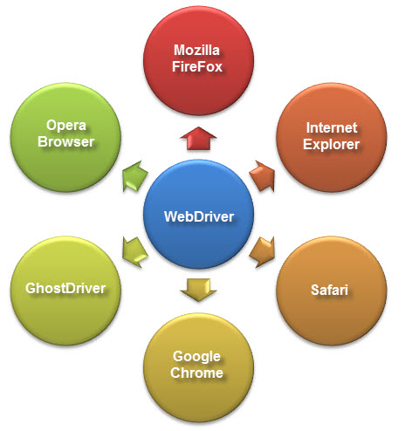
Selenium Web Driver
Selenium Web Driver is the successor to Selenium RC.
Accepts commands (sent in Selenese, or via a Client API) and sends them to a browser.
This is implemented through a browser-specific browser driver, which sends commands to a browser, and retrieves results.
Most browser drivers actually launch and access a browser application (such as Firefox or Internet Explorer); there is also an HtmlUnit browser driver, which simulates a browser using HtmlUnit.
Unlike in Selenium 1, where the Selenium RC server was necessary to run tests, Selenium Web Driver does not need a special server to execute tests.
Instead, the Web Driver directly starts a browser instance and controls it. However, Selenium Grid can be used with Web Driver to execute tests on remote systems.

Slide 14
Object Identification
To identify the objects such as Links, Buttons, Edit boxes, Drop downs, etc on the application Selenium uses a concept called “Locators”.
Element Locators
ID: id=foo
Name: name=foo
XPath: xpath=//table[@id='table1']//tr[4]/td[2]
Link Text: link=sometext
CSS Selector: css=a[href=“#id3”]

Slide 15
Sample Coding of Selenium
driver. get("http://www.google.com"); To open an application
driver.findElement(By.id("passwd-id")); Finding Element using Id
driver.findElement(By.name("passwd")); Finding Element using Name
driver.findElement(By. Xpath("//input[@id=’passwd-id’]")); Finding Element using Xpath
element.sendKeys("some text"); To type some data
element. clear(); clear the contents of a text ﬁeld or text area
driver.findElement(By. Xpath("//select")); Selecting the value
findElement(By.id("submit")).click(); To click on Any button/Link
driver.switchTo().window("window Name"); Moving from one window to another window
driver.switchTo().frame("frame Name"); swing from frame to frame (or into iframes)
driver.switchTo().frame("frameName.0.child"); access sub frames by separating the path with a dot, and can specify the frame by its index too.
driver.switchTo().alert(); Handling Alerts
driver. Navigate().to("http://www.example.com"); To Navigate Particular URL
driver. Navigate().forward(); To Navigate Forward
driver. Navigate().back(); To Navigate Backward
driver. close() Closes the current window
driver. Quit() Quits the driver and closes every associated window.
driver.switch_to_alert() Switches focus to an alert on the page.
driver. Refresh() Refreshes the current page
driver.get_screenshot_as_file('/Screenshots/foo.png') The full path you wish to save your screenshot to
driver.get_screenshot_as_base64() Gets the screenshot of the current window as a base64 encoded string
select.findElements(By.tagName("option")); Selecting the value
select.deselectAll(); This will deselect all OPTIONs from the ﬁrst SELECT on the page
select.selectByVisibleText("Edam"); select the OPTION with the displayed text of “Edam”
getClass(), getCurrentUrl(), getPageSource(), getTitle(), getText(), getAttribute(), getWindowHandle(), getWindowHandles().

Slide 16
Test Project Design
Workflows
Test Suite
Pages
Test Project
POM
Test Driven Development
Environment Setup
Reporting
Logging/Tracing

Slide 17
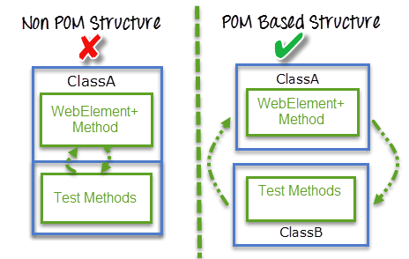
Page Object Model
Page Object Model is a design pattern to create Object Repository for web UI elements.
It says operations and flows in the UI should be separated from verification. This concept makes our code cleaner and easy to understand.
Object repository is independent of testcases, so we can use the same object repository for a different purpose with different tools. For example, we can integrate POM with TestNG/JUnit for functional testing and at the same time with JBehave/Cucumber for acceptance testing.
Code becomes less and optimized because of the reusable page methods in the POM classes.
Methods get more realistic names which can be easily mapped with the operation happening in UI. i.e. if after clicking on the button we land on the home page, the method name will be like 'gotoHomePage()'.
Reduce LOC, Maintainable, Readable, Pluggable, Separation of concerns between pages and Test classes.

Slide 18
Sample IDE Code vs POM
/**** Tests login functionality*/
public void loginTestCase()
{
driver.navigate().to(URL);
driver.findElement(By.name("signIn")).click();
driver.findElement(By.id("username")).sendKeys("testuser")
driver.findElement(By.id("password")).sendKeys("testpassword");
driver.findElement(By.name("loginbtn")).click();
String Expected=driver.findElement(By.id("message")).getText();
Assert.assertEquals(Expected, "Welcome");
}
/**** Tests login functionality Using POM*/
public void loginTestCase()
{
LoginPage.LoginTOApplication(“Sanjay”, ”1234”);
Assert.assertEquals(Expected, "Welcome");
}

Slide 19
Nunit Framework
NUnit is a unit testing framework for performing unit testing based on the .NET platform
The points to be remembered about NUnit are listed below:
NUnit is not an automated GUI testing tool.
It is not a scripting language, all tests are written in .NET supported languages, e.g., C#, VC, VB.NET, J#, etc.

Slide 20
Nunit Attributes
1. TextFixture Attribute
The TestFixture attribute is an indication that a class contains test methods. When you mention this attribute to a class in your project, the Test Runner application will scan it for test methods. The following code illustrates the usage of this attribute as in the following: using System; using NUnit.Framework; using System.Text;
namespace UNitTesting { [TestFixture] public class Program { } }

Slide 21
3. SetUp
SetUp is generally used for initialization purposes. Any code that must be initialized or set prior to executing a test is put in functions marked with this attribute. As a consequence, it avoids the problem of code repetition in each test.
Note: After execution of each test its gets call.
[SetUp]
public void Xyz()
{
.
.
}
4. OneTimeSetUp
OneTimeSetUp is generally used for one time initialization purposes irrespective of number of tescases. The pupose is same as Setup but it will be called only one time in TesFixture.
[OneTimeSetUp]
public void Xyz()
{
.
.
}

Slide 22
5. Test Attribute
The Test attribute indicates that a method within a test fixture should be run by the Test Runner application. The method must be public, return void, and will not be run when the Test Fixture is run. The following code depicts the use of this attribute as in the following:
[TestFixture] public class Program { [Test] public void Test() { ... } }

Slide 23
6. TearDown
This is an attribute that acts the opposite of [SetUp]. It means the code written with this attribute is executed last (after passing other lines of code). So, inside this closing is generally done, i.e., closing of file system, database connection, etc.
7. OneTimeTearDown
This is an attribute that acts the opposite of [OneTimeSetUp]. It means the code written with this attribute is executed last but only once in a TestfFxture. So, inside this closing is generally done, i.e., closing of file system, database connection, etc.

Slide 24
3. Assert Class
the Assert class is used to confirm whether the test cases is producing the expected result or not using its auxiliary methods such as AreEqual() or AreNotEqual().

Slide 25
Test Project Design
Test
Pages
Driver Extensions
Web Element Extensions
Kendo Extensions
Logger
Reports helper
AFS Automation Framework
Hooks Driver
factory page
Driver Services
Test Data Driven
Config file
Web Application

